Slide 1

App Overview & Stack Context
This slide orients Claude Code. Fill in your details below.
Tech Stack
App Summary
Frontend: Next.js (implemented)
Backend: python
ORM / Migrations: SQLAlchemy + Alembic
Database: SQlite
Deployment: Vercel
An app used to explain to engineers & education professionals the ‘why’ and ‘how’ of a potential weeklong education unit. The ‘Stories’ feature contains slideshows on why this program might be good for students & professionals. The ‘Design’ feature shows the interactive tools which compose the subsystems of the windmill fleet.
User Roles / Personas
Key Decisions Already Made
This app shall be public, no auth or concept of user.
The existing home page and logic should not be overwritten. The HTTP API pattern has been established.

Slide 2

Navigation Map
Show how screens connect. Replace this with your own diagram or annotate below.
Home /
Stories /stories
Design /design
Individual Story /stories/:id
Subsystem Overview /design/:id
Subsystem Detail /design/:id/detail
All of the lines represent two-way flows.

Slide 3

Home (Landing Page)
Screen 1
/
Desktop
Mobile
Design
Design
About
About
Purpose
Key Interactions
Data Shown
Edge Cases & States
The user changes the speed of the wind. The interactions & logic are already built in the page, in page.tsx.
Users adjust a sliding bar at the bottom of the screen (not pictured, exists on main.tsx)
The data shown is already implemented in main.tsx.
No loading. There are background illustrations. No concept of state necessary.

Slide 4

Stories
Screen 2
/stories
Desktop
Mobile
For Students
For Students
For Professionals
For Professionals
Purpose
Key Interactions
Data Shown
Edge Cases & States
User clicks one of two buttons
Buttons lead to individual stories (/stories/:id)
Two buttons
None

Slide 5


Individual Story (Template)
Screen 3
/stories/:id
Desktop
Mobile
Top text
Top text
Bottom text
Bottom text
Purpose
Key Interactions
Data Shown
Edge Cases & States
This page mimics Instagram story functionality. The number of bars at the top, correspond to the number of slides in this story. A slide is the unique combination of top text, bottom text, and image.
Top text moves left to right, slowly. Bottom text moves right to left. Slow zoom in on whatever image is shown. Click (tap) advances slides. Click (tap) and hold stops the slide. Each slide has 6 seconds.
Each slide has its unique top text, bottom text, and image.
The page will need to know which slide is currently showing, so it can go forward & back from that slide.
When the slideshow ends, go ‘back’ to the Stories page.

Slide 6

Design
Screen 4
/design
Desktop
Mobile
Blades
Blades
Drivetrain
Drivetrain
Purpose
Key Interactions
Data Shown
Edge Cases & States
User clicks one of two buttons
Buttons lead to individual stories (/design/:subsystemId)
Two buttons
None

Slide 7
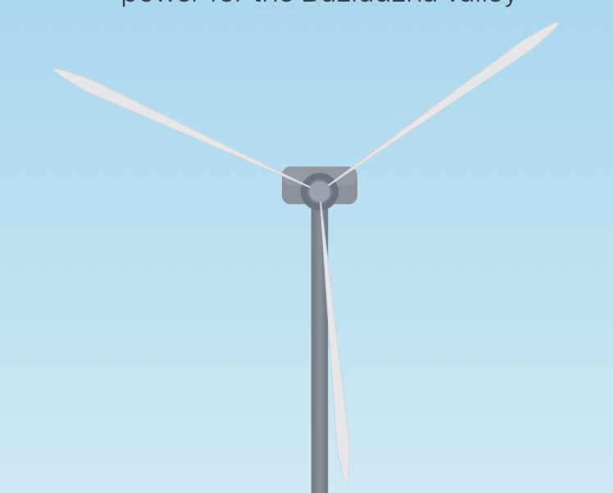
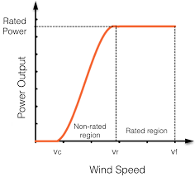
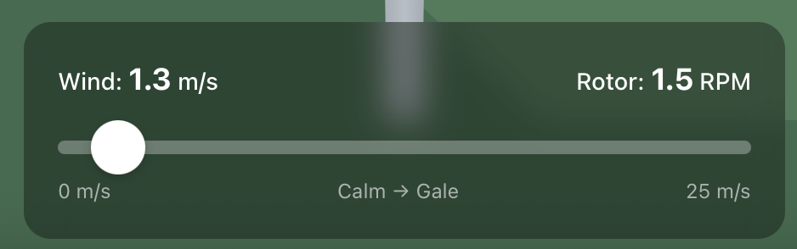
Subsystem Design Overview
Screen 5
/design/:subsystemId
Desktop
Mobile
Back to Design
Blade Design
Back to Fleet
Blade Cross-Section
weight:
cost:
avg output:
efficiency:
180
180
180
180
# of blades:
3
# of blades:
3
weight:
cost:
180
avg output:
efficiency:
180
180
180
Purpose
Key Interactions
Data Shown
Edge Cases & States
The user inputs the number of blades and uses the slider to control the animation of blades & the dotted line on the chart to the right. Calculated values are output to the yellow boxes.
Moving the slider
Inputting the number of blades, creates equally spaced blades on the turbine rotor.
Back to fleet goes to home. Blade design goes to
Text data is: weight, cost, avg output, efficiency. The chart is also interactive, x-axis is wind speed and y-axis is power generated.
Number of blades drives the weight, cost, avg output, and efficiency output values. The slider changes the animation on the blades and on the chart.

Slide 8

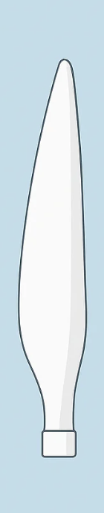
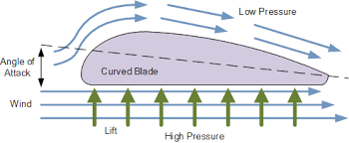
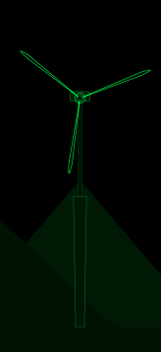
Subsystem Design Detail
Screen 6
/design/:subsystemId/detail
Desktop
Mobile
Pressure
FEA
Back to Blades
Pressure diff:
Resultant velocity:
180
blade
width:
Pressure diff:
Resultant velocity:
180
Save section shape
blade width:
↑
↑
↑
↑
180
180
blade length:
↑
↑
blade
length:
↑
Save section shape
↑
Purpose
Key Interactions
Data Shown
Edge Cases & States
The purpose of this page is to allow a user to design a windmill’s blades by editing the cross sectional area and shape. 10 discrete length locations of the blade can be modified by adjusting the slider on the right. The blade width and length can be adjusted. In the future (not now) cross sectional shape should be adjustable by click-and drag, but retain a base airfoil shape.
On left: rotating windmill which displays overall blade shape. In middle: The arrows represent either airflow or pressure around a section of the airfoil. Their length corresponds to their magnitude. The user slides the two dials (angle of attack top, wind speed bottom). Save section shape, saves the shape of this cross section.
On right: A single blade is shown. The slider controls where along the length of blade the visible cross section is. Blade width and blade length are controlled by arrow buttons.
Green arrows: Pressure gradient, caused by wind velocity, angle of attack, and shape of the blade. Larger arrow = more pressure.
Blue arrows: Animated wind flow. Equal magnitude. Velocity of wind flow based on wind velocity slider, angle of attack, and shape of blade. Not picture but should be shown: blade height, width cost.
The value of the slider corresponds to a value on the blade’s radial axis. This state must be known, as the values of angle of attack and shape of the cross section, are saved for each length value. The windmill animation (far left) must know the overall blade geometry (shown on right)

Slide 9

Shared Patterns & Conventions
Document global decisions so Claude Code doesn't reinvent them.
Navigation & Routing
API Response Format
Routing buttons will have subtle arrow shapes.
API responds with JSON.
UI Components & Styling
Content & Animations
The UI should be OK for colorblind people. The styles can hopefully be modelled after the latest iOS UI.
The ‘Individual Stories’ feature should mimic the user action of Instagram stories. The app is small enough that static assets can be used.

